Slide 1

Files and Streams
Using Streams, Files, Serialization
Advanced
Java
SoftUni Team
Technical Trainers
Software University
https://softuni.bg

Slide 2
Table of Contents
Streams Basics
Opening a File Stream
Closing a File Stream
Types of Streams
Combining Streams
Files and Directories
Serialization

Slide 3
Have a Question?
sli.do
#java-advanced

Slide 4

Streams

Slide 5


What is Stream?
Streams are used to transfer data
We open a stream to:
Read a file
Write to a file
1100 1001 1001
Stream
5

Slide 6

Streams Basics
Two fundamental types of streams:
1100 1001 1001
Input Stream
Streams are unidirectional!
1100 1001 1001
Output Stream

Slide 7
Opening a File Stream
String path = "C:\\input.txt";
FileInputStream fileStream =
new FileInputStream(path);
int oneByte = fileStream.read();
while (oneByte >= 0) {
System.out.print(oneByte);
oneByte = fileStream.read();
}
Returns -1 if empty

Slide 8
Closing a File Stream (1)
Using try-catch-finally
InputStream in = null;
try {
in = new FileInputStream(path);
} catch (IOException e) {
// TODO: handle exception
} finally {
if (in != null) {
in.close();
}
}
close() can also throw an exception
Always free resources!

Slide 9
Closing a File Stream (2)
Using try-with-resources
try (InputStream in = new FileInputStream(path)) {
int oneByte = in.read();
while (oneByte >= 0) {
System.out.print(oneByte);
oneByte = in.read();
}
} catch (IOException e) {
// TODO: handle exception
}

Slide 10
Problem: Read File
You are given a file
Read and print all of its contents as a sequence of bytes
Submit in Judge only the output of the program
Two households, both alike in dignity, In fair Verona, where we lay our scene,
1010100 1110111 1101111 100000 1101000 1101111 1110101 1110011 1100101 1101000…
Check your solution here: https://judge.softuni.bg/Contests/1493/Streams-Files-And-Directories-Lab

Slide 11

Solution: Read File
String path = "D:\\input.txt";
try (InputStream in = new FileInputStream(path)) {
int oneByte = in.read();
while (oneByte >= 0) {
System.out.printf("%s ", Integer.toBinaryString(oneByte));
oneByte = in.read();
}
}
catch (IOException e) {
e.printStackTrace();
}

Slide 12
Problem: Write to File
Read a file and write all its content while skipping any
punctuation (skip ',', '.', '!', '?')
Submit in Judge only the output of the program
Two households, both alike in dignity.
In fair Verona, where we lay our scene.
Two households both alike in dignity
In fair Verona where we lay our scene
Check your solution here: https://judge.softuni.bg/Contests/1493/Streams-Files-And-Directories-Lab

Slide 13


Solution: Write to File (1)
String inputPath = "D:\\input.txt";
String outputPath = "D:\\output.txt";
List<Character> symbols = new ArrayList<>();
Collections.addAll(symbols, '.', ',', '!', '?');
// continues…
Check your solution here: https://judge.softuni.bg/Contests/1493/Streams-Files-And-Directories-Lab

Slide 14
Solution: Write to File (2)
try (InputStream in = new FileInputStream(inputPath);
OutputStream out = new FileOutputStream(outputPath)) {
int oneByte = 0;
while ((oneByte = in.read()) >= 0) {
if (!symbols.contains((char)oneByte)) {
out.write(oneByte);
}
}
} // TODO: handle exceptions
Check your solution here: https://judge.softuni.bg/Contests/1493/Streams-Files-And-Directories-Lab

Slide 15

Basic Stream Types in Java
Byte and Character

Slide 16
Byte Stream
Byte streams are the lowest level streams
Byte streams can read or write one byte at a time
All byte streams descend from InputStream and OutputStream
InputStream
100101 | 111111 | 100011 | -1
OutputStream
100101
111111
100011

Slide 17
Problem: Copy Bytes
Read a file and copy its contents to another text file
Write characters as bytes in decimal
Write every space or new line as it is, e.g. as a space or new line
T
w
o
space
Two households, both alike in dignity.
In fair Verona, where we lay our scene.
84119111 10411111711510110411…
73110 10297105114 861011141111109744 1…
Check your solution here: https://judge.softuni.bg/Contests/1493/Streams-Files-And-Directories-Lab

Slide 18
Solution: Copy Bytes
// TODO: Open input and output streams
int oneByte = 0;
while ((oneByte = in.read()) >= 0) {
if (oneByte == 10 || oneByte == 32) {
out.write(oneByte);
} else {
String digits = String.valueOf(oneByte);
for (int i = 0; i < digits.length(); i++)
out.write(digits.charAt(i));
}
} // TODO: handle exceptions
Check your solution here: https://judge.softuni.bg/Contests/1493/Streams-Files-And-Directories-Lab

Slide 19
Character Streams
All character streams descend from FileReader and FileWriter
String path = "D:\\input.txt";
FileReader reader = new FileReader(path);
19

Slide 20
Combining Streams
Character streams are often "wrappers" for byte streams
FileReader uses FileInputStream
FileWriter uses FileOutputStream
String path = "D:\\input.txt";
Scanner reader =
new Scanner(new FileInputStream(path));
Wrapping a Stream

Slide 21
Problem: Extract Integers
Read a file and extracts all integers in a separate file
Get only numbers that are not a part of a word
Submit in Judge only the output of the program
2 households, 22 alike in 3nity, In fair Verona, where we lay our scene
2
22
Check your solution here: https://judge.softuni.bg/Contests/1493/Streams-Files-And-Directories-Lab

Slide 22
Solution: Extract Integers
Scanner scanner =
new Scanner(new FileInputStream(inputPath));
PrintWriter out =
new PrintWriter(new FileOutputStream(outputPath));
while (scanner.hasNext()) {
if (scanner.hasNextInt())
out.println(scanner.nextInt());
scanner.next();
}
out.close();
Check your solution here: https://judge.softuni.bg/Contests/1493/Streams-Files-And-Directories-Lab

Slide 23
Buffered Streams
Reading information in chunks
Significantly boost performance
Length = 9
F i l e s a n d
46 | 69 | 6c | 65 | 73 | 20 | 61 | 6e | 64
Position
Buffer
46 | 69
6c | 65
73 | 20
61 | 6e
64

Slide 24

Problem: Write Every Third Line
Read a file and write all lines which number is divisible by 3 in a separate file
Line numbers start from one
Two households, both alike in dignity, In fair Verona, where we lay our scene, From ancient grudge break to new mutiny…
10101
Check your solution here: https://judge.softuni.bg/Contests/1493/Streams-Files-And-Directories-Lab

Slide 25
Solution: Write Every Third Line
try (BufferedReader in =
new BufferedReader(new FileReader(inputPath));
PrintWriter out =
new PrintWriter(new FileWriter(outputPath))) {
int counter = 1;
String line = in.readLine();
while (line != null) {
if (counter % 3 == 0)
out.println(line);
counter++;
line = in.readLine();
}
} // TODO: handle exceptions
Check your solution here: https://judge.softuni.bg/Contests/1493/Streams-Files-And-Directories-Lab

Slide 26
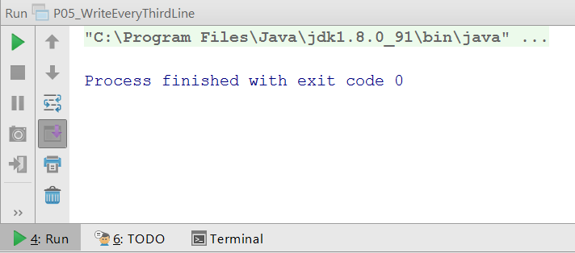
Command Line I/O (1)
Standard Input - System.in
Standard Output - System.out
Standard Error - System.err
Input Stream
Scanner scanner = new Scanner(System.in);
String line = scanner.nextLine();
System.out.println(line);
Output Stream

Slide 27
Command Line I/O (2)
public static void main(String[] args) throws IOException {
BufferedReader reader =
new BufferedReader(new InputStreamReader(System.in));
String hello = reader.readLine(); // Hello BufferedReader
System.out.println(hello); // Hello BufferedReader
}

Slide 28

Files and Paths
Easily Working With Files

Slide 29
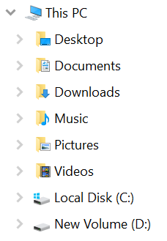
Paths
The location of a file in the file system
Represented in Java by the Path class
D:\input.txt
Path path = Paths.get("D:\\input.txt");
Root folder
D:\
input.txt
other files

Slide 30

Files (1)
Provides static methods for creating streams
Path path = Paths.get("D:\\input.txt");
try (BufferedReader reader =
Files.newBufferedReader(path)) {
// TODO: work with file
} catch (IOException e) {
// TODO: handle exception
}

Slide 31

Files (2)
Provides utility methods for easy file manipulation
Path inPath = Paths.get("D:\\input.txt");
Path outPath = Paths.get("D:\\output.txt");
List<String> lines = Files.readAllLines(inPath);
Files.write(outPath, lines);
// TODO: handle exceptions

Slide 32

Problem: Sort Lines
Read a text file and sort all lines
Write the result to another text file
Use Paths and Files classes
C
A
B
D
…
A
B
C
D
…
Check your solution here: https://judge.softuni.bg/Contests/1493/Streams-Files-And-Directories-Lab

Slide 33
Solution: Sort Lines
Path path = Paths.get("D:\\input.txt");
Path output = Paths.get("D:\\output.txt");
try {
List<String> lines = Files.readAllLines(path);
lines = lines.stream().filter(l ->
!l.isBlank()).collect(Collectors.toList());
Collections.sort(lines);
Files.write(output, lines);
} catch (IOException e) {
e.printStackTrace();
}
Don't use for large files
Check your solution here: https://judge.softuni.bg/Contests/1493/Streams-Files-And-Directories-Lab

Slide 34

File Class in Java
Easily Working With Files

Slide 35

File Class in Java
Provides methods for quick and easy manipulation of files
import java.io.File;
File file = new File("D:\\input.txt");
boolean isExisting = file.exists();
long length = file.length();
boolean isDirectory = file.isDirectory();
File[] files = file.listFiles();

Slide 36
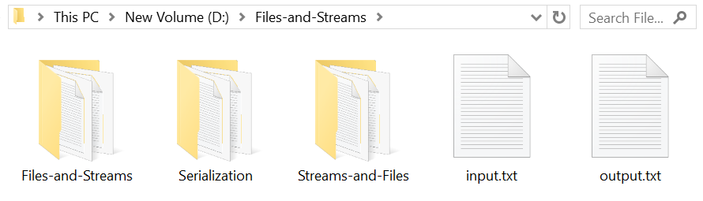
Problem: List Files
Print names and sizes of all files in "Files-and-Streams" directory
Skip child directories
input.txt: [size in bytes]
output.txt: [size in bytes]
Check your solution here: https://judge.softuni.bg/Contests/1493/Streams-Files-And-Directories-Lab

Slide 37

Solution: List Files
if (file.exists()) {
if (file.isDirectory()) {
File[] files = file.listFiles();
for (File f : files) {
if (!f.isDirectory()) {
System.out.printf("%s: [%s]%n",
f.getName(), f.length());
}
}
}
}

Slide 38
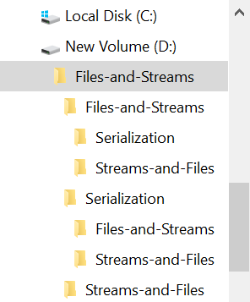
Problem: Nested Folders
You are given a folder named "Files-and-Streams"
List all folder names, starting with the root
Print folder count on the last line (including the root)
…
Streams-and-Files
Serialization
Streams-and-Files
[count] folders
Check your solution here: https://judge.softuni.bg/Contests/1493/Streams-Files-And-Directories-Lab

Slide 39
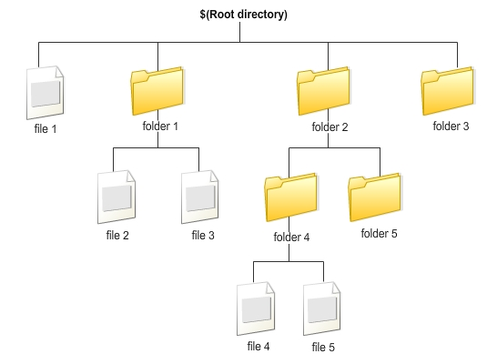
Solution: Nested Folders (1)
String path = "D:\\Files-and-Streams";
File root = new File(path);
Deque<File> dirs = new ArrayDeque<>();
dirs.offer(root);
// continue…
Check your solution here: https://judge.softuni.bg/Contests/1493/Streams-Files-And-Directories-Lab

Slide 40
Solution: Nested Folders (2)
int count = 0;
while (!dirs.isEmpty()) {
File current = dirs.poll();
File[] nestedFiles = current.listFiles();
for (File nestedFile : nestedFiles)
if (nestedFile.isDirectory())
dirs.offer(nestedFile);
count++;
System.out.println(current.getName());
}
System.out.println(count + " folders");
Check your solution here: https://judge.softuni.bg/Contests/1493/Streams-Files-And-Directories-Lab

Slide 41



Serialization
Serializing and Deserializing Objects

Slide 42
Serialization
Save objects to a file
List<String> names = new ArrayList<>();
Collections.addAll(names, "Mimi", "Gosho");
FileOutputStream fos = new FileOutputStream(path);
ObjectOutputStream oos =
new ObjectOutputStream(fos);
oos.writeObject(names);
// TODO: handle exceptions
Save objects to .ser file

Slide 43
Deserialization
Load objects from a file
FileInputStream fis =
new FileInputStream(path);
ObjectInputStream oos =
new ObjectInputStream(fis);
List<String> names =
(List<String>) oos.readObject();
// TODO: handle exceptions

Slide 44

Serialization of Custom Objects
Custom objects should implement the Serializable interface
class Cube implements Serializable {
String color;
double width;
double height;
double depth;
}

Slide 45
Problem: Serialize Custom Object
Create a Cube class with color, width, height and depth
Create a cube – color: "green", w: 15.3, h: 12.4 and d: 3
Check your solution here: https://judge.softuni.bg/Contests/1493/Streams-Files-And-Directories-Lab

Slide 46
Solution: Serialize Custom Object (1)
class Cube implements Serializable {
String color;
double width;
double height;
double depth;
}
Check your solution here: https://judge.softuni.bg/Contests/1493/Streams-Files-And-Directories-Lab

Slide 47
Solution: Serialize Custom Object (2)
//TODO: Create Cube object
String path = "D:\\save.ser";
try (ObjectOutputStream oos = new ObjectOutputStream(
new FileOutputStream(path))) {
oos.writeObject(cube);
} catch (IOException e) {
e.printStackTrace();
}
Check your solution here: https://judge.softuni.bg/Contests/1493/Streams-Files-And-Directories-Lab

Slide 48

Summary
…
…
…
Streams are used to transfer data
Two main types of streams
Input Streams
Output Streams
Buffered streams boost performance
Streams can be chained together
You can save objects state into a file

Slide 49
Questions?
Notes:
49

Slide 50











SoftUni Diamond Partners

Slide 51



Educational Partners

Slide 52
Trainings @ Software University (SoftUni)
Software University – High-Quality Education, Profession and Job for Software Developers
softuni.bg
Software University Foundation
softuni.foundation
Software University @ Facebook
facebook.com/SoftwareUniversity
Software University Forums
forum.softuni.bg
52
Notes:
52

Slide 53

License
This course (slides, examples, demos, exercises, homework, documents, videos and other assets) is copyrighted content
Unauthorized copy, reproduction or use is illegal
© SoftUni – https://about.softuni.bg
© Software University – https://softuni.bg
Notes:
53

